Slide 1
Unit 6: Content
Dr. D de Villiers : 19th August 2014
System Development method:
  System Development method: XP – Chapter 23 pp 479 – 481
Approach:
  Agile approach: RAD – Chapter 7 pp 119-150 & Chapter 8 pp 161-163
Techniques
  Functional decomposition, Time boxing, Pareto principle, MoSCoW rules, JAD work sessions, Prototyping, User stories, Paired programming – Chapter 7 pp 128-134

Slide 2
Unit 6 : Chapter 23
System Development method: XP

Slide 3
Extreme Programming (XP)
User stories
Architectural spike
Paired programming

Slide 4
Extreme Programming (XP)
Planning
Designing
Developing
Productionalising

Slide 5
Unit 6: Chapter 7
Agile approach: RAD

Slide 6
RAD
It is not based upon the traditional life cycle, but adopts an evolutionary/prototyping approach
It focuses upon identifying the important users and involving them via workshops at early stages of development
It focuses on obtaining commitment from the business users
It requires a toolset with a sophisticated repository

Slide 7
RAD
Requirements planning
User design
Construction
Cutover

Slide 8
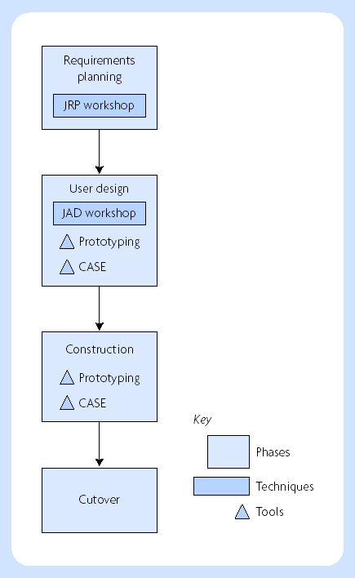
Phases of the RAD approach

Slide 9
Unit 6: Chapter 7
Techniques

Slide 10
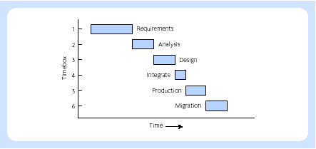
Timeboxes

Slide 11
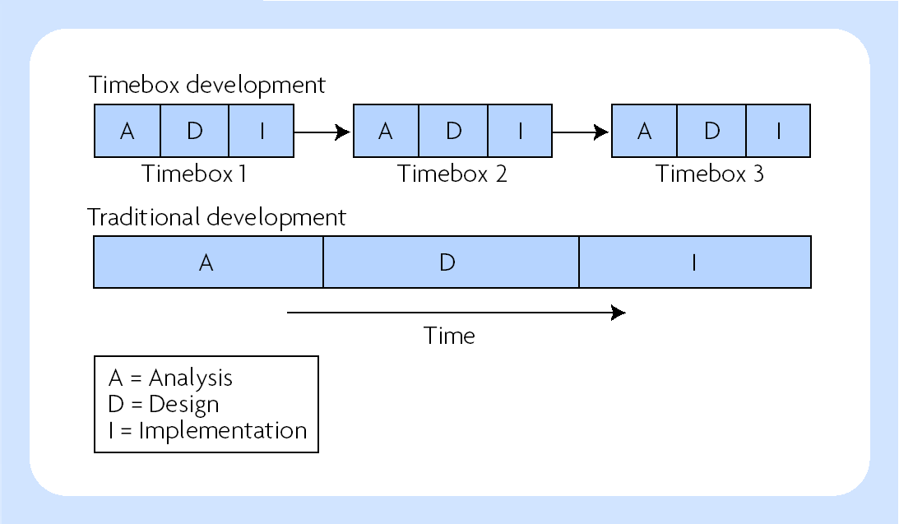
Rapid Application Development (RAD)
Incremental development
Timeboxing
The pareto principle
MoSCoW rules
JAD workshops
Prototyping
Sponsor and champion
Toolsets

Slide 12
MoSCoW Rules
M = ‘the Must Haves’. Without these features the project is not viable, i.e. these are the minimum critical success factors fundamental to the projects success
S = ‘the Should Haves’. To gain maximum benefit these features will be delivered but the projects success does not rely on them.
C = ‘the Could Haves’. If time and resources allow these features will be delivered but they can easily be left out without impacting on the project.
W = ‘the Won't Haves’. These features will not be delivered. They can be left out and possibly, although not necessarily, be done in a later timebox

Slide 13
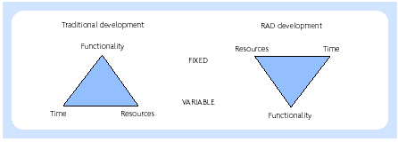
Traditional development

Slide 14
Questions?

